Slide 1
Data Mining
Fall 2022, IUB
Sahithi
Sayali
CH. Venkata Viswanath
Employee Churn modelling and
prediction

Slide 2


Presentation flow
Abstract & Problem Statement
EDA
Preprocessing
Dimensionality Reduction
Model application & Evaluation
Conclusion

Slide 3
e
Abstract :
Churn is defined as one’s tendency to discontinue their subscription towards the products or services in one party and switch to another within the given time. This phenomenon commonly occurs in customer loyalty towards brand products or services. It is a critical issue that every industry looks to avoid.
Employee Churn occurs within the organization and can cause huge losses to the organization. A successful prediction model for employee churn is significantly needed in order to avert various negative impacts for the organization. The project does a comparative analysis of how various algorithms predict the Employee churn value.

Slide 4
Problem Statement :
With the huge recession and mass lay-offs going across the world, Employee Churn modelling has become a highly impactful problem to tackle.
Understanding why and when the employees are most likely to leave can lead to the following actions
Improve employee retention
Possibly planning new hiring in advance.
If a situation comes for the company to lay off its employees for any organizational adjustments, it can use Churn modelling to make a calculated move instead of making random lay off choices.

Slide 5
Exploratory Data Analysis:
Schema Analysis
Uni-variate analysis
Bi-variate
analysis
Multi-variate analysis
Correlation
Bar Graphs- Qualitative
Box plots-Quantitative
- Analysis between multiple feature columns and the target column
Shape
Memory Usage
head()
- Analysis between a feature column and target column
- Spearman correlation among the variables.

Slide 6
Data Preprocessing:
Feature Selection
Missing data
Features & Target
Encoding categorical data
Splitting the dataset
Feature scaling
- Handling the Missing data.
Numerical – Mean
String - Frequent
- Separating the features and target column
One Hot Encoder
Label Encoder
- Removing the irrelevant columns
- Generating the Train and Test datasets
Standardization technique

Slide 7
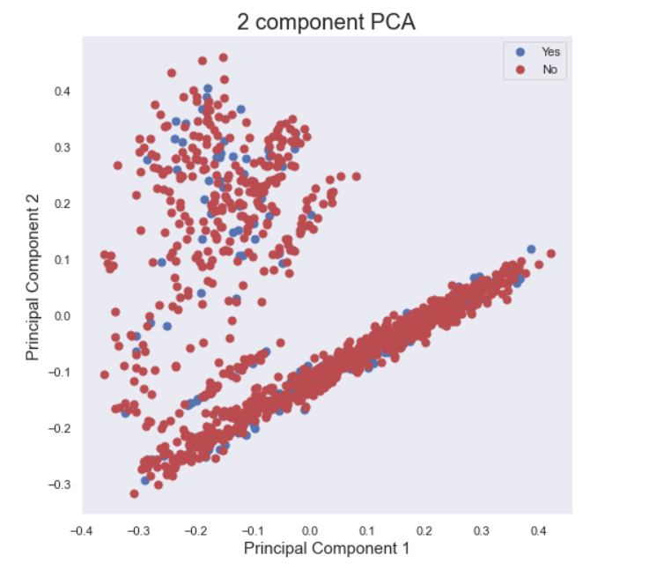
Dimensionality Reduction:
Principal Component Analysis – PCA, 2-components

Slide 8
Classification Models and Evaluation metrics:
Logistic Regression
K-Nearest Neighbors
SVM & Kernel SVM
Naïve Bayes
Decision Tree
Accuracy – 85.03%
K-fold CV accuracy – 88.52%
Accuracy – 82.99%
K-fold CV accuracy – 86.82%
* Grid Search
Accuracy – 78.23%
K-fold CV accuracy – 79.16%
Accuracy – 85.03%
K-fold CV accuracy – 88.35%
Accuracy – 78.91%
K-fold CV accuracy – 85.54%
Accuracy – 67.00%
K-fold CV accuracy – 69.72%

Slide 9
Classification Models and Evaluation metrics:
Random Forest
Bagging Classifier
AdaBoost Classifier
XGBoost Classifier
Artificial Neural Network
Accuracy – 82.31%
K-fold CV accuracy – 86.56%
Accuracy – 80.27%
K-fold CV accuracy – 84.77%
Accuracy – 78.57%
K-fold CV accuracy – 78.14%
Accuracy – 83.33%
K-fold CV accuracy – 86.56%
Accuracy –
79.25%
3 hidden layers

Slide 10
Conclusion :
The dataset has more values comparatively for Attrition values “No”, when compared to “Yes”. The data is not completely fair, yet, we were able to get accuracies above 85%
We also observe from Dimensionality reduction that the data is not completely linearly separable. From the above classification models, we see that Logistic Regression, SVM and Kernel SVM, Random Forest and XGBoost Classifier provide better accuracies comparatively. We used the K-Fold cross-validation techniques to ensure that we did not get lucky with the accuracy calculation since the mean accuracy of 10-fold cross-validation is close to that of the test accuracy.

Slide 11
Future work :
We were successfully able to model and predict the Employee Attrition values with the help of various independent features. This can be clubbed with the clustering techniques to further analyse the attrition of a particular cluster of employees. Companies can work on Employee retention by using this model.
We can extend this model for more features. Companies in the current situations can hire us and use our model to filter their employees instead of choosing random lay-offs.

Slide 12
Thank You

